Slide 1
SHOPPING APPLICATION
Using Console
Wiley Edge Training
Project 1

Slide 2
Content
Team Info
Project Info
Tech Stack (Java concepts applied)
Project Architecture Diagram
Project Architecture Description of class files and flow
Screenshots
Retrospective
Next?
03/05/2023
Wiley Edge

Slide 3
Team Info
Anmol Sahu
Karthikeya S
Kritika Motiramani
Prajwal Bawankule
Praveen Rao V P
Priya Raj
Raj Chourasia
Shalu Mishra
Shreyash Matele
Supratim Maity
Swati Jha
Vandana Thakur
03/05/2023
Wiley Edge

Slide 4
Project Info
This app simulates the working of an online shopping portal
It is purely java console- based application
Two users :
Admin Panel – functions provided like register, managing products (add,delete,view,search) and managing customers
Customer Panel – functions provided like viewing products, searching for products, adding and removing products from the cart, view the cart, and proceeding to the payment function.
03/05/2023
Wiley Edge

Slide 5
Tech stack
Coding Language : Java
Concepts used :
Classes and Objects
String manipulations
Collections framework
Exception Handling
Inheritance
File Handling
03/05/2023
Wiley Edge

Slide 6
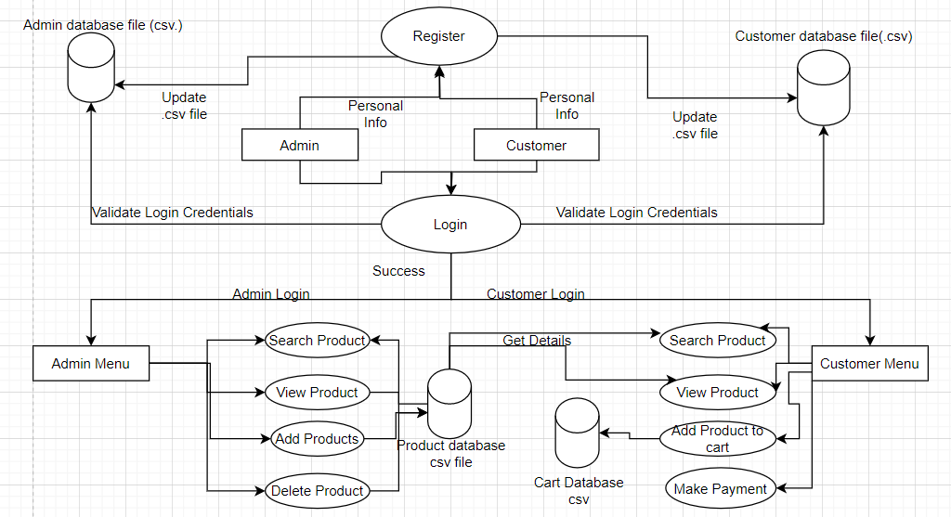
Project Architecture Diagram
Fig : Architecture Diagram
03/05/2023
Wiley Edge

Slide 7
Project Architecture Diagram Description
The model consists of 2 users admin and customer.
Admin and customer can register and login into the system. Their registration data is stored into admin database(.csv file) and customer database(.csv) respectively.
Admin can add product, view product, search product, delete product. The product details are stored in product database(.csv)
Customer can view products, search products, add product to cart, make payment. Cart database(.csv file) is used to store the products added to cart.
03/05/2023
Wiley Edge

Slide 8
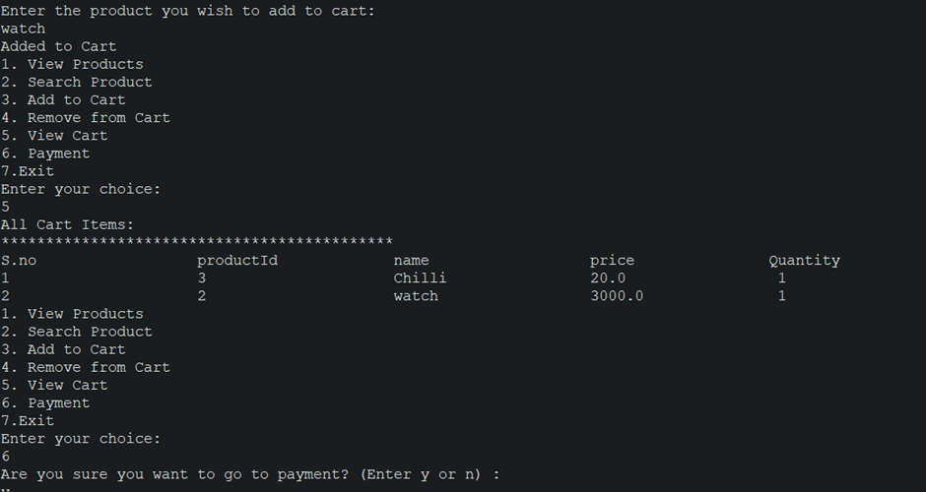
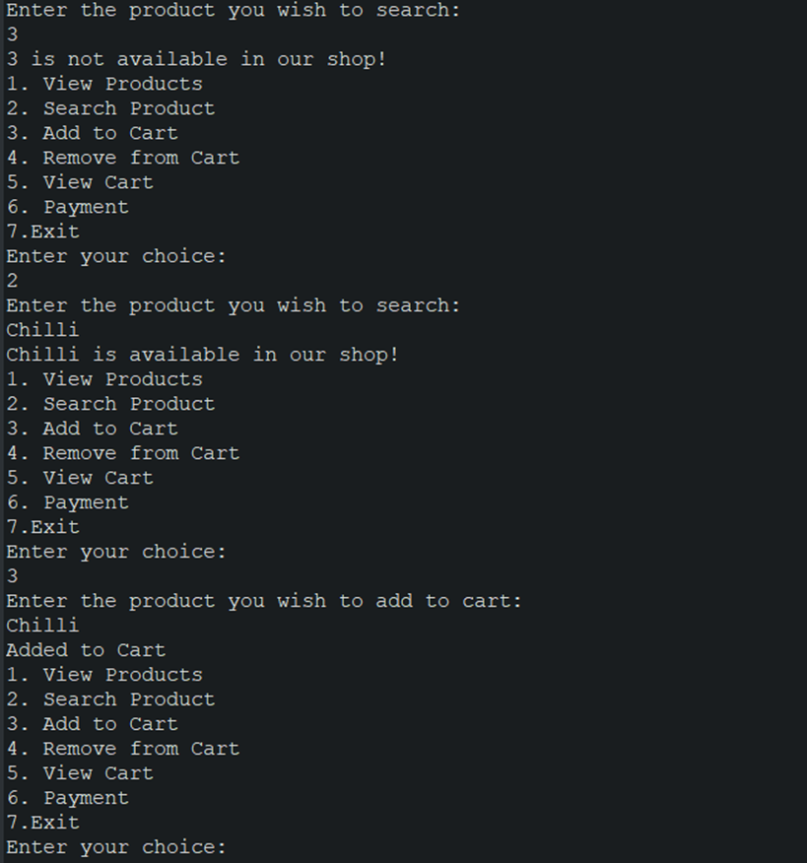
Screenshots
03/05/2023
Wiley Edge

Slide 9
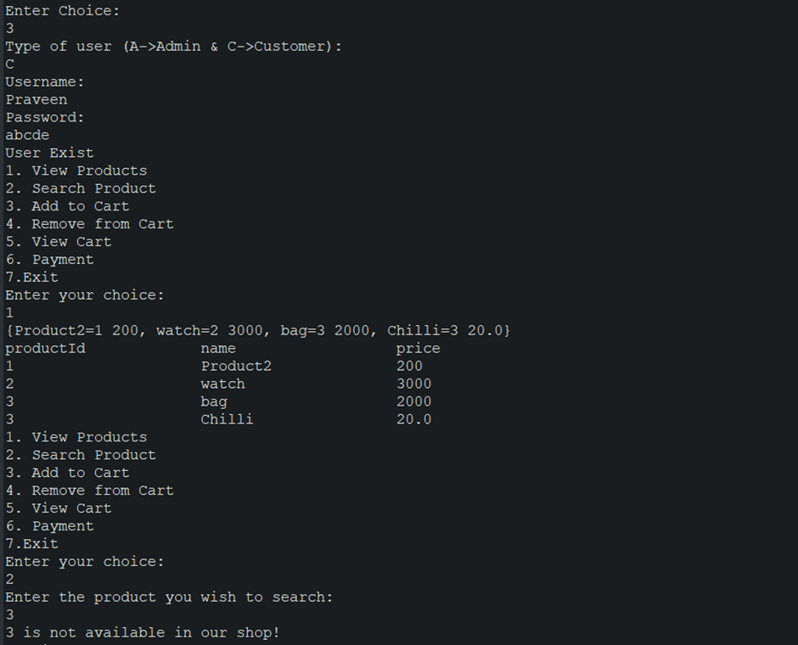
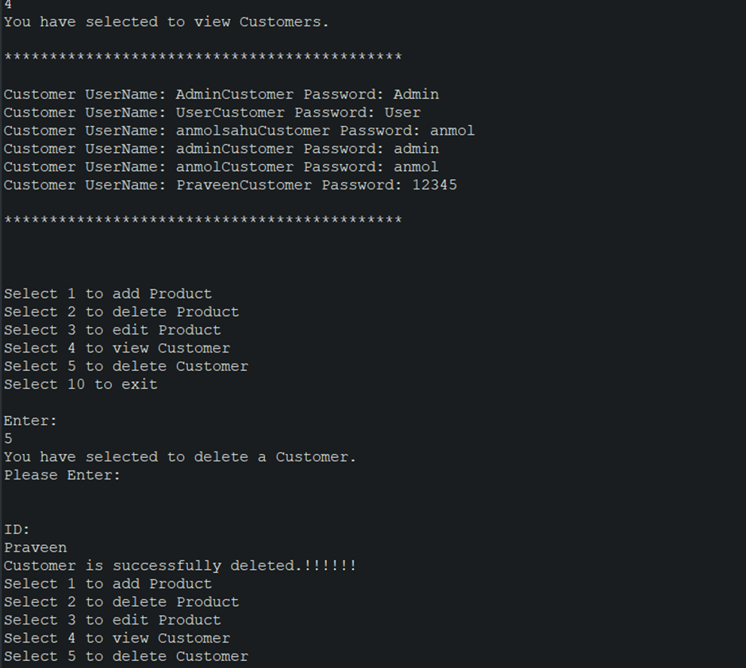
Screenshots

Slide 10
Retrospective
Improving the design of the application so that it is easy to use and navigate for the user.
Adding more functionalities.
Fixing the bugs in the existing application.
03/05/2023
Wiley Edge

Slide 11
Next?
Adding more functionalities to the application.
Making the application more user friendly.
Creating a UI for the project.
03/05/2023
Wiley Edge

